Slide 1
Netflix Application
Jude Orsua
Sabrina Gonzalez

Slide 2
Project Explanation
Brief Explanation of our topic and application:
Our project is a show recommendation based on a variety of criteria from different shows available on Netflix
User can search for a specific movie title
User can filter a show recommendation based on different criterias
User can add shows to a like and dislike list
User can have a random show be recommended to them
Data consists of listings of all the movies and tv shows available on Netflix, along with details such as - cast, directors, ratings, release year, duration, title, country, date added, genre, and description

Slide 3
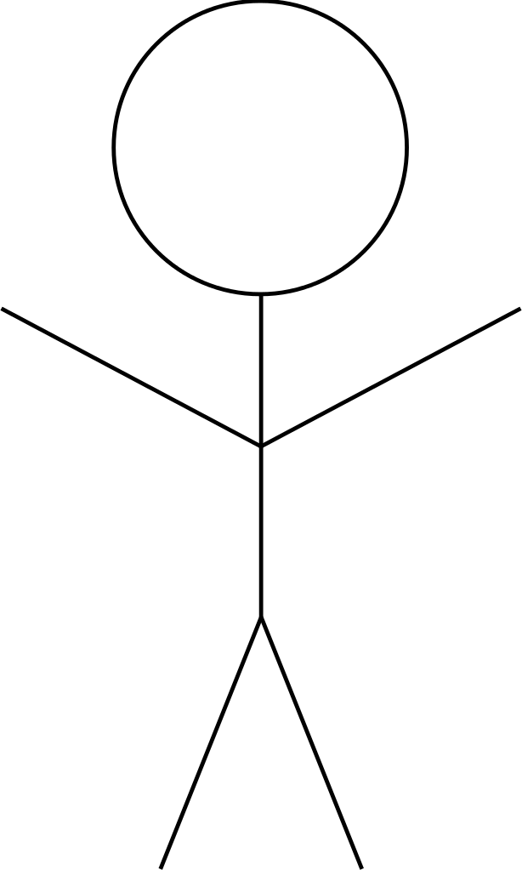
Use -Case Diagram
Netflix Application
Search
Uses
Extend
Dislike
User
Filter
Extend
Like
Extend
Remove Like
Uses
Random

Slide 4
E/ R Diagram and Relational Schema
Dislike
d_sid
d_dislike
Like
l_sid
l_like
Dislike
Like
Movies
m_sid
m_title
m_cast
m_description
Shows
s_sid
s_title
s_cast
s_description
Like
Dislike
Have
Have
Release
re_sid
re_release
re_added
Rating
ra_sid
ra_rating
ra_stars
Genre
g_sid
g_genre

Slide 5
GitHub Repository
https://github.com/SabrinaGonz/DatabaseSystems-Project

